Slide 1
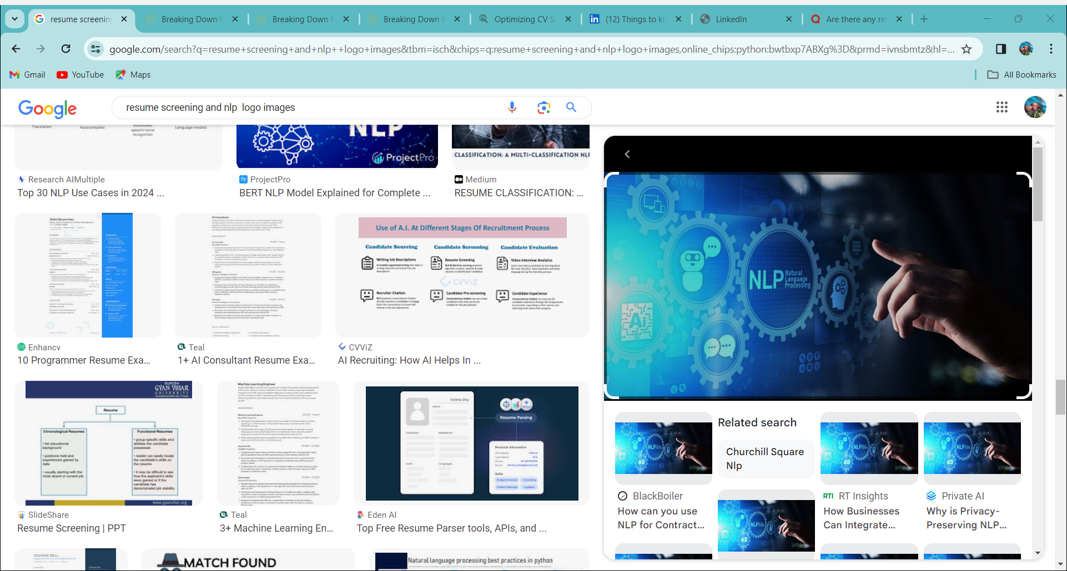
NLP PROJECT
Resume classification

Slide 2
Content used
1.Project Architecture.
2.Project Goal.
3.Dataset Details.
4. Data Pre-processing and EDA
5.Visualization.
6. Model building
7. Model deployment

Slide 3
Project Architecture
Converting zip file to unzip file
Converting pdf to doc texter
Reading all the details from the given categories
Data cleansing
Creating new csv files

Slide 4
Project goal
The document classification solution should significantly reduce the manual human effort in the HRM. It should achieve a higher level of accuracy and automation with minimal human intervention. This can help save time and resources in the recruitment process, improve the quality of hires, and enhance the overall efficiency of the hiring process.
Used Python's libraries to implement various NLP techniques like tokenization, lemmatization, parts of speech tagging, etc.

Slide 5
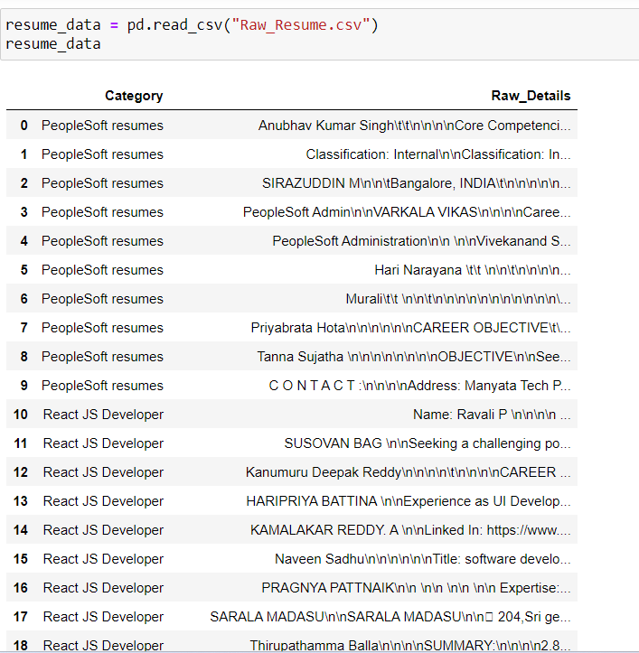
Data set details
Resumes
Category: The resumes are divided into 4 category they are react JS developer , SQL developer , workday ,People soft resumes.
Raw_Details : The resumes raw data is stored in Raw_Details

Slide 6
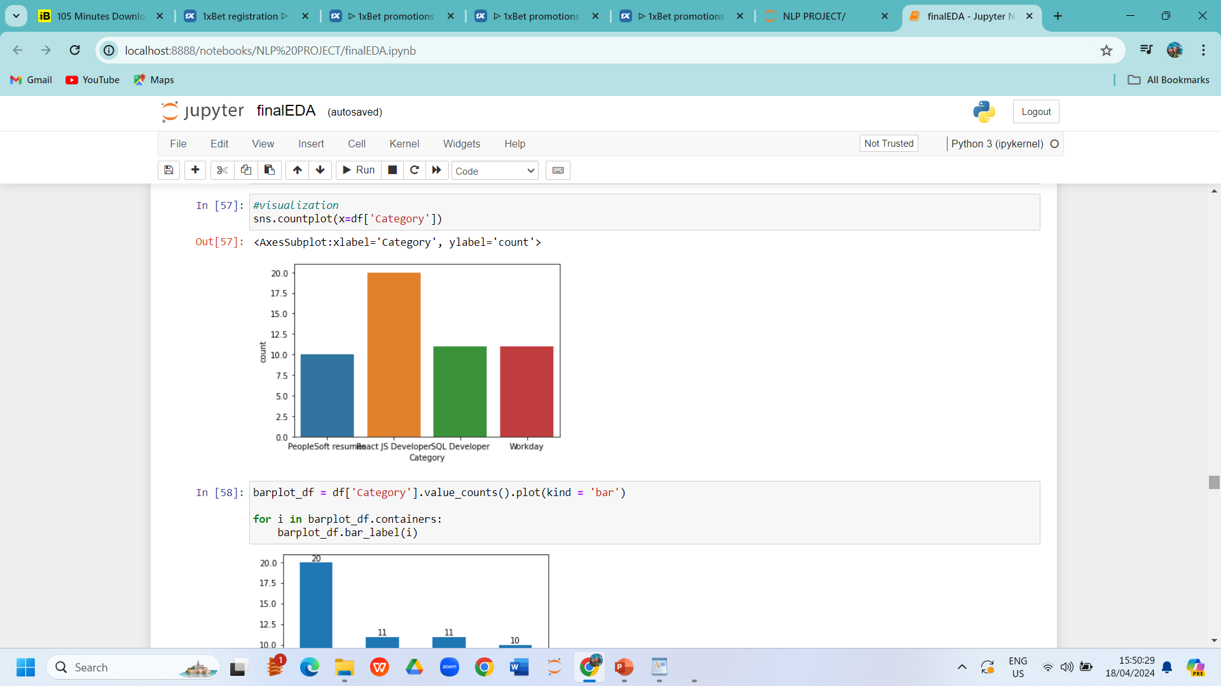
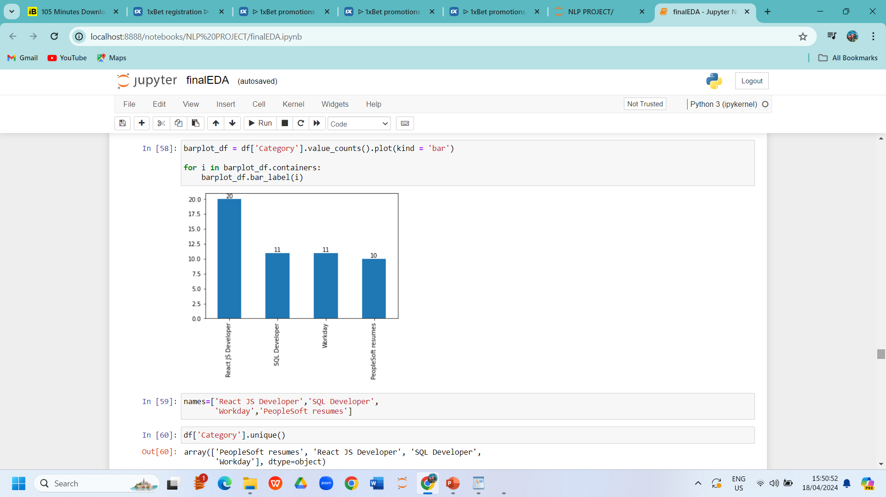
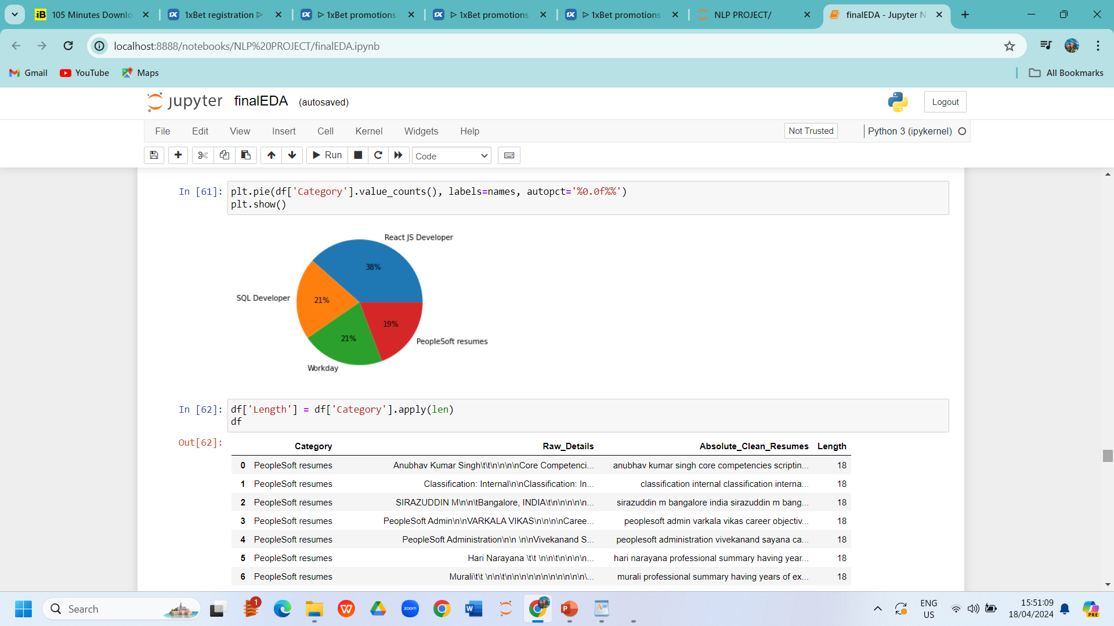
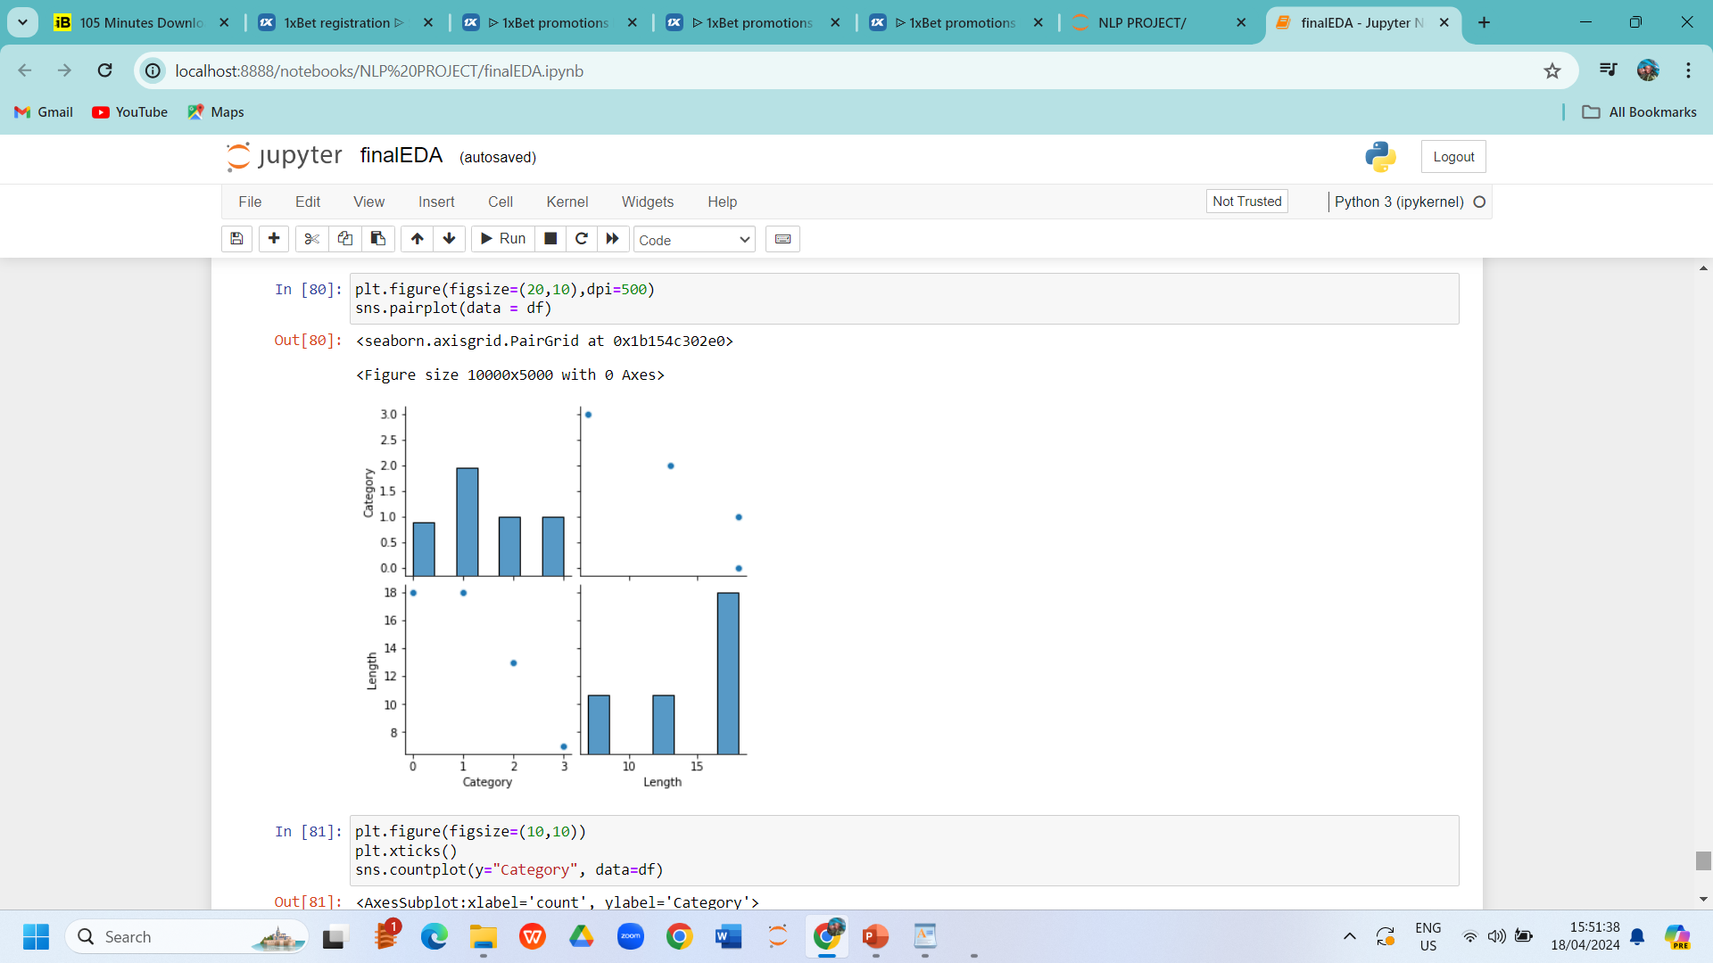
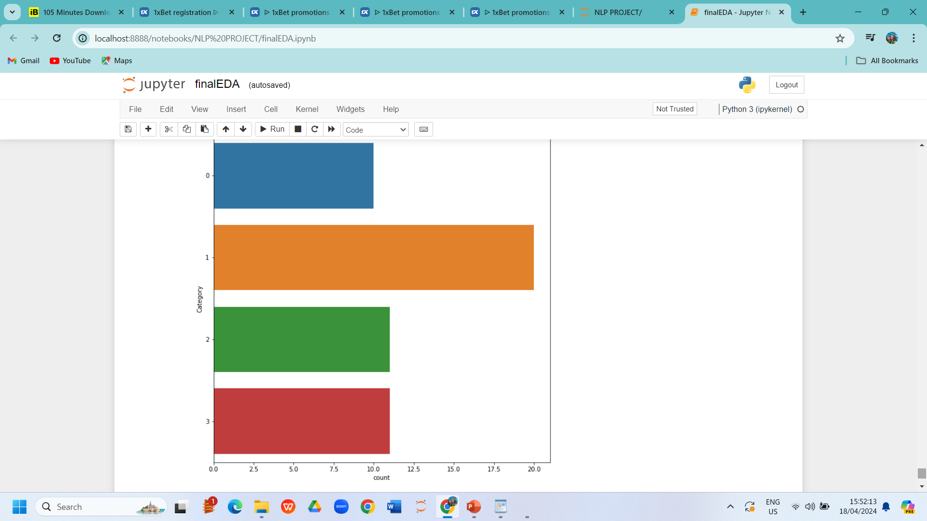
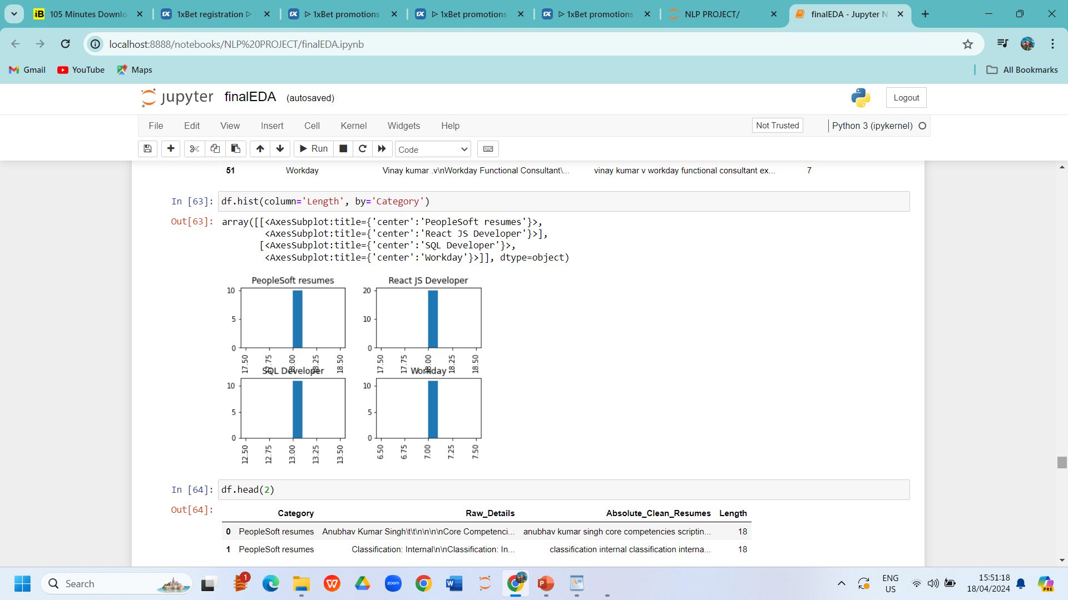
Data PREPROCESSING AND EDA

Slide 7
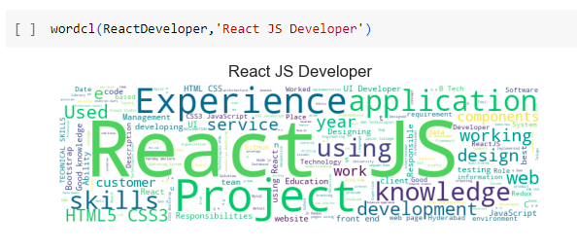
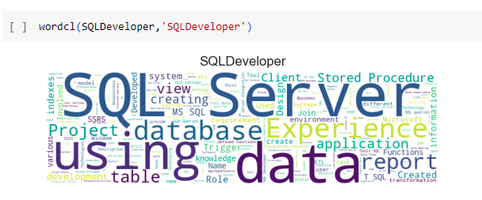
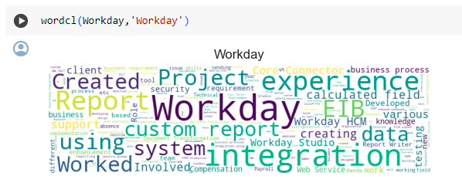
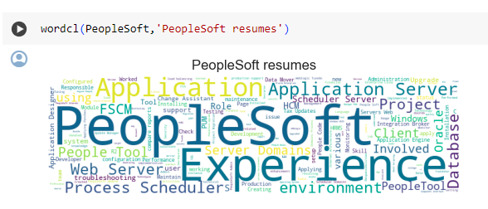
Word cloud

Slide 8
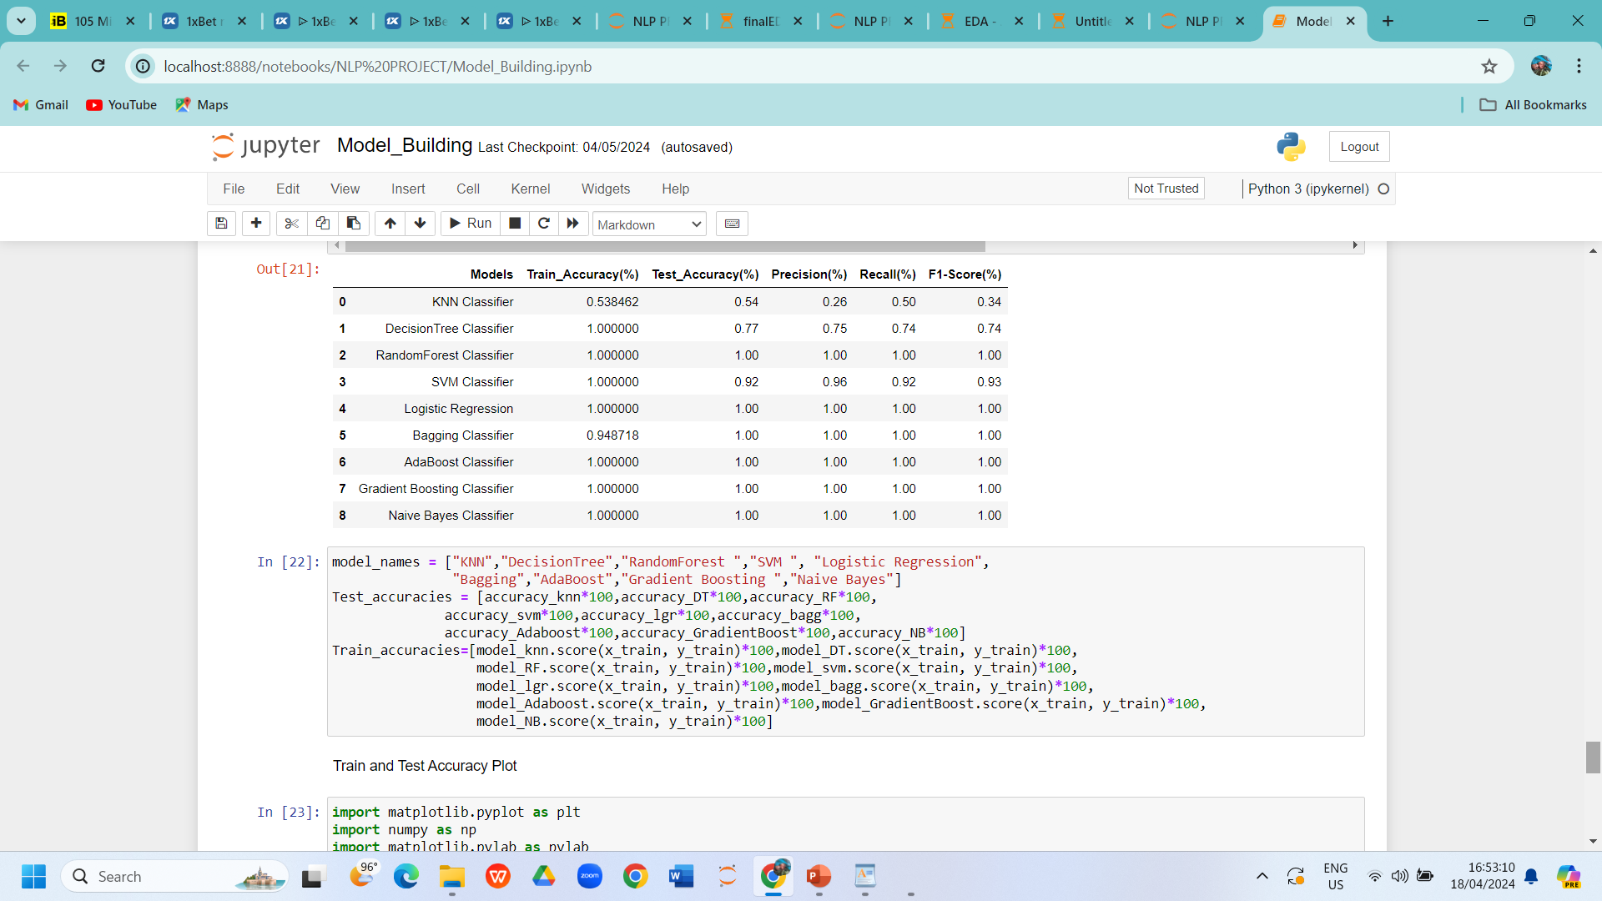
Model building
For model building we used different type of model building codes like KNN , Decision Tree , Random Forest , SVM , Logistic Regression, Bagging , AdaBoost , Gradient Boost , Naive Bayes for the best model to provide the best resumes to the users.

Slide 9
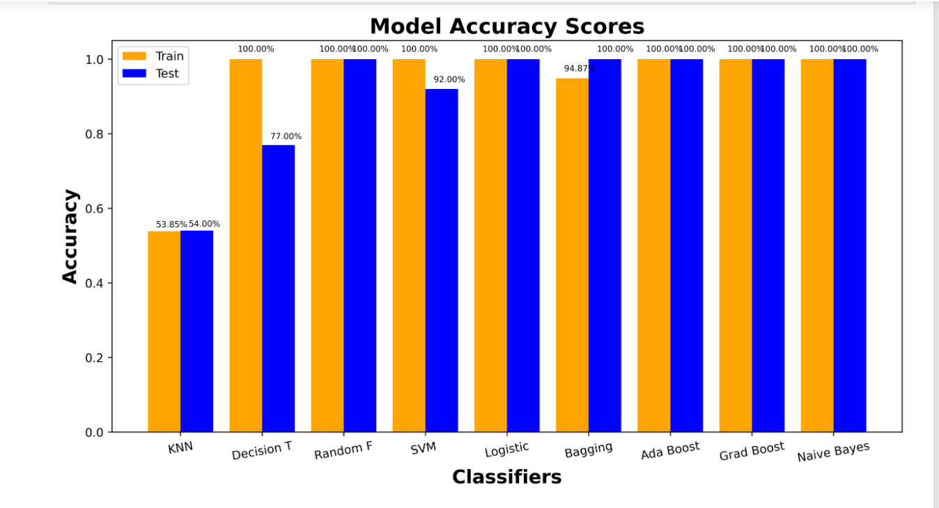
Model evaluation

Slide 10
Overall report
In Resume screening with NLP we have cleaned the dataset and tokenized the words and fit the models.
In which Random forest, Logistic Regression, AdaBoost , Gradient Boost , Naive Bayes algorithms performs well with high accuracy.

Slide 11
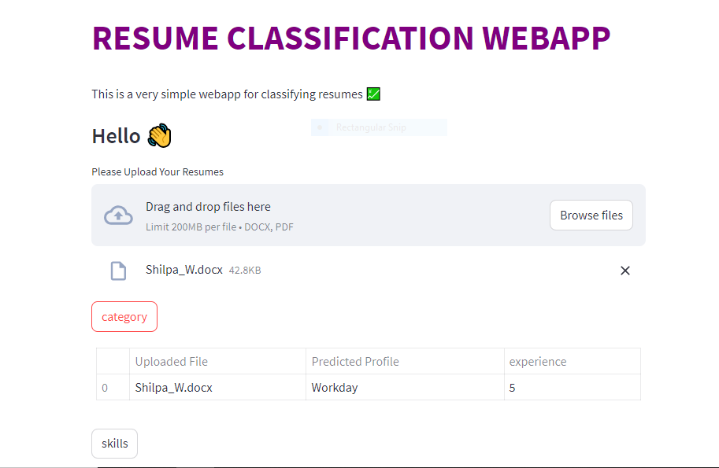
Model deployment

Slide 12
challenges
In Start, We face difficulty with the dataset ,we have four categories in that all the data are in pdf files then we converted pdf to doc text format and done the data cleaning process in which we created 2 csv files raw resumes and cleaned resumes file with these files we continued the process
In that pre-processed data we found the relationship between variables. EDA is an interesting part but the selection of variables and making more effective visualization is quite a tough task.
A most difficult task for the team to build an accurate model and to evaluate we used KNN , Decision Tree , Random Forest , SVM , Logistic Regression, Bagging , AdaBoost , Gradient Boost , Naive Bayes for the best model to provide the best resumes to the users.
In model evaluation we find the accuaracy score of all the models that mentioned above and plotted a bar chart to illustrate the accuracy and classifiers .
In deployment, we learned streamlit and Python for making a good interface. It takes time and continuous discussion in the team and we did make a great app page

Slide 13
Thank you

